Slide 1
Data Ingestion

Slide 2
Data Ingestion
Data Types
Data Sources
Embeddings
Window and Stride

Slide 3
Data Ingestion - Why
Problem:
LLMs are trained offline on a massive corpus and unaware of events after training
LLMs do not know your business proprietary or domain specific data
LLMs do not have real-time information
Solution:
Feed the LLM relevant context in real-time, by using an information retrieval system

Slide 4


Slide 5
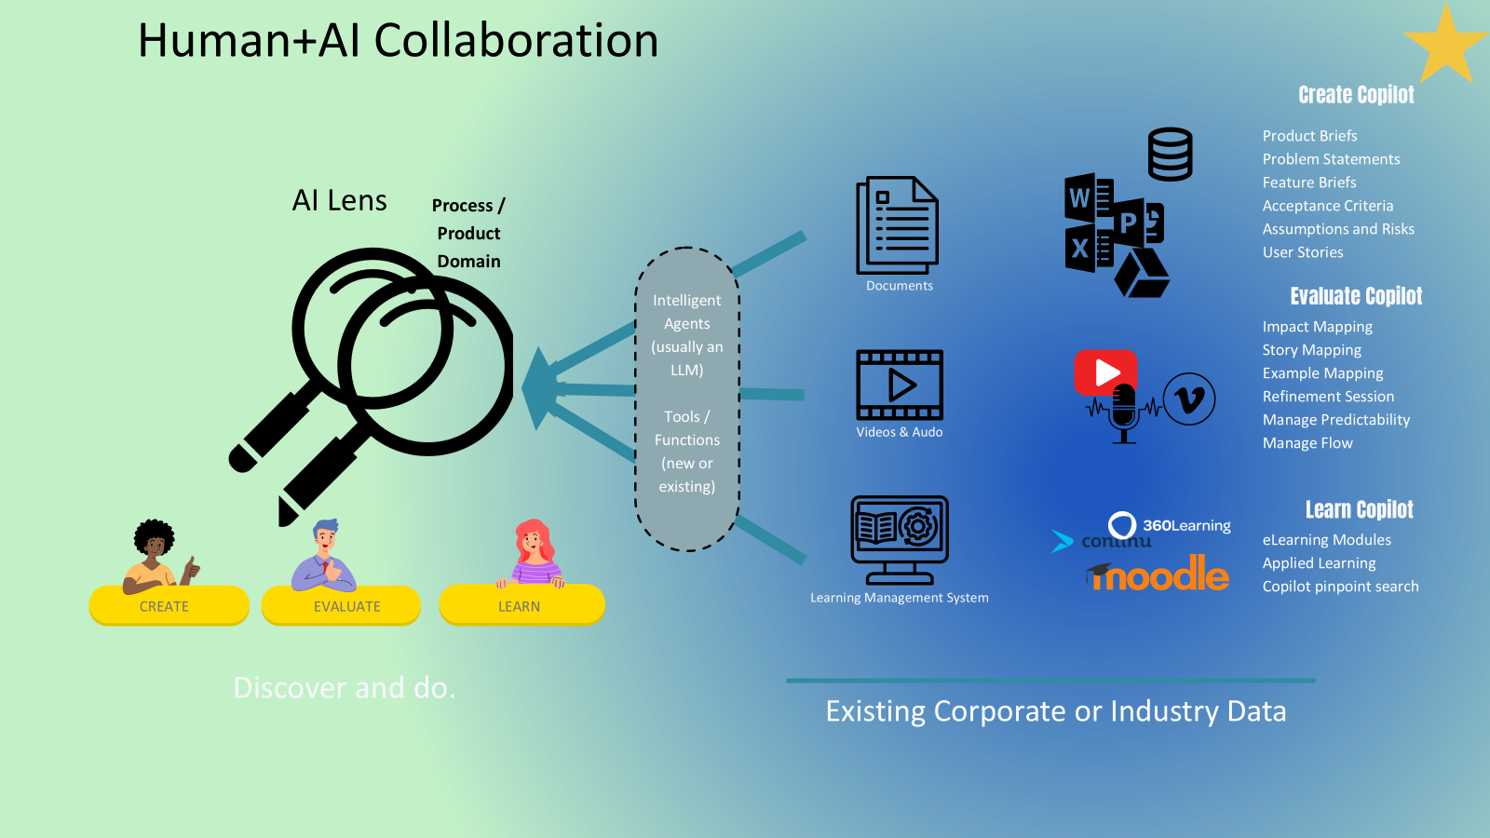

Slide 6
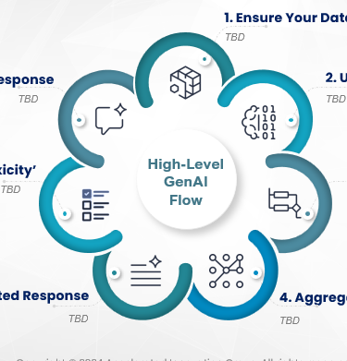

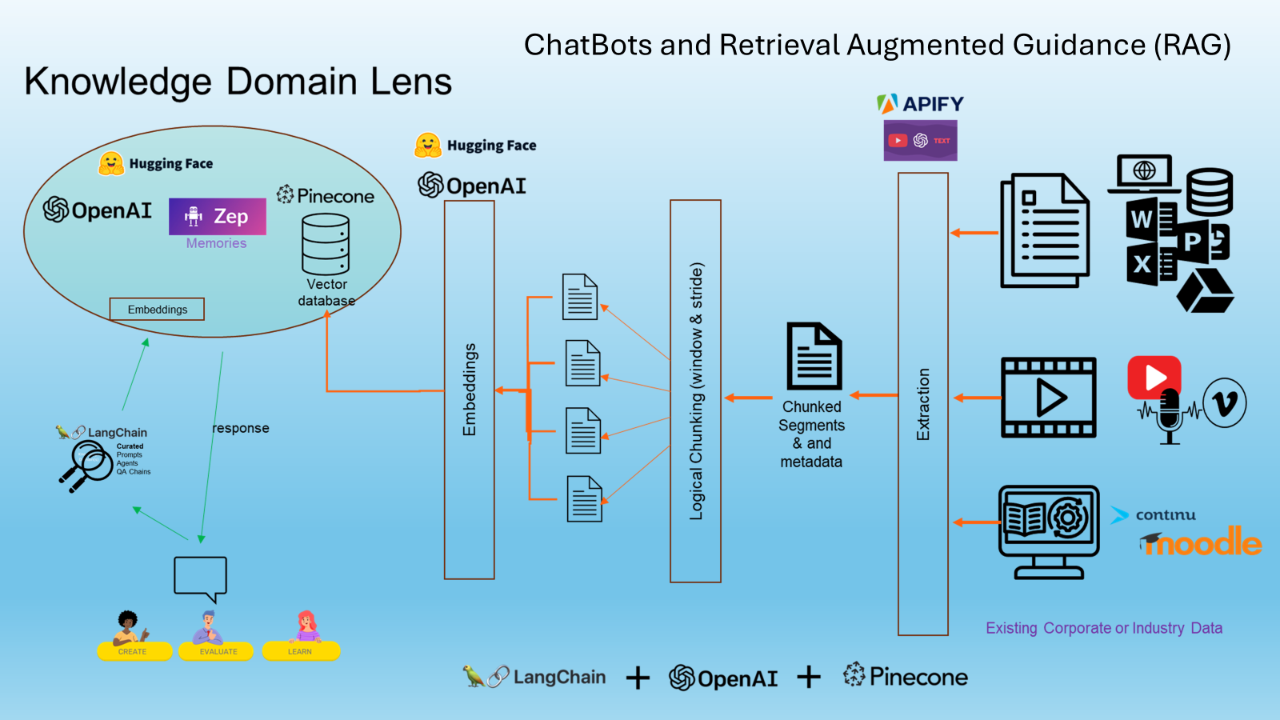
Right-Left
Use case
Which data
Architecture? All the details.. Circle in the right corner of the slide – navigation guide

Slide 7
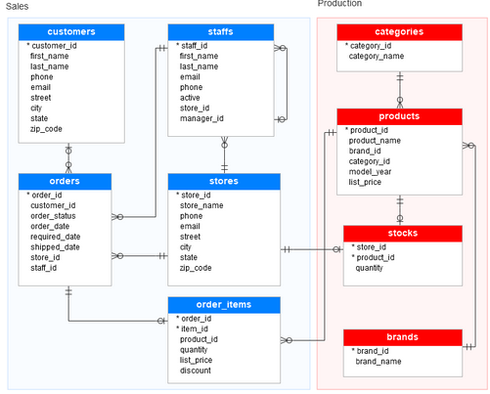
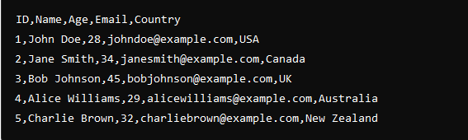
Types of Data: Structured
Database
Comma separated variables - CSV

Slide 8




Types of Data: Unstructured
Text
Video
Image

Slide 9
Data Sources
Databases
API (Application Programming Interface)
Web Scraping
Public Datasets
Wikipedia API
IMDB API
OpenWeatherMap API
Twitter API
Spotify API
NASA API
BeautifulSoup
Scrapy
Selenium (Browser Automation
Cheerio (Node.js Library)
Kaggle Datasets
AWS Public Datasets
Data.gov
OpenStreetMap
NASA Earthdata
MySQL
Microsoft SQL Server
MongoDB
PostgreSQL
Examples
References
MySQL Tutorial
What is an API?
YouTube BeautifulSoup Tutorial
Kaggle Datasets Introduction
PyPi Wikipedia-API

Slide 10
Data Collection Techniques
Surveys and Questionnaires
Observational Methods
Experiments
Secondary Data Sources
Behavioral Studies
User Experience Research
Field studies
Ecological research
Clinical trials
Psychological research
Educational interventions
Product testing
Economic Analysis
Demographic studies
Meta-analysis
Policy research
SurveyMonkey
Qualtrics Survey Software
Examples
References
SurveyMonkey
Observational Research Methods
Experimental Research Methods
NIH Need for Secondary Research

Slide 11
LangChain Framework for Data Ingestion
LangChain Document Loaders
LangChain Embedding Models
LangChain Vectorstores

Slide 12
Embeddings
Imagine you have a book, and you want to summarize each page into a single number that captures its meaning. But instead of just one number, you use a list of numbers, and each number represents a different feature of that page, like the theme, the emotions, or the topics covered. These lists of numbers are called embeddings.
In more detail, embeddings are a way to represent complex information, like words or sentences, in a simpler way using numbers. These numbers are like coordinates that help place words or sentences in a space where similar things are closer together, and different things are farther apart.
For example:
The words "cat" and "dog" might be close together in the space because they’re both animals and pets.
The word "car" would be farther away from "cat" because they have different meanings.

Slide 13

Embeddings - Why
Using embeddings in RAG systems significantly enhances the retrieval process by enabling semantic search, improving accuracy, and ensuring that the generation component has access to the most relevant information. This results in more accurate, contextually appropriate, and user-satisfying outputs.
1
By leveraging embeddings, RAG systems can move beyond the limitations of traditional keyword-based retrieval, handling complex queries, and providing high-quality responses that align closely with user intent. This makes embeddings a critical component in the development of advanced, efficient, and effective RAG systems.
2

Slide 14
Window and Stride
Imagine you're trying to read a really big book, but instead of reading the whole thing at once, you decide to read it bit by bit. To do this, you take a window, like a piece of paper with a cut-out hole, and place it over a few lines of the book to see only a small part at a time.
- The window is like a frame that covers only a part of the text, allowing you to focus on a specific section. For example, if the book has a thousand lines, and your window shows ten lines, you can only read those ten lines at once.
- The stride is how far you move the window each time. If your stride is small, you move the window a little bit, which means you see a lot of overlapping text between each move. If your stride is large, you move the window further, which means there is less overlap, or none at all, between what you saw before and what you see now.
In artificial intelligence, especially in natural language processing, window and stride are used to divide text into manageable chunks:
- window size determines how much text is considered at once.
- stride determines how much the window shifts to capture the next part of the text.
Using overlapping windows (a small stride) helps the AI keep context between sections, while using a larger stride can make things faster but may miss some details.

Slide 15
Q&A

Slide 16
Coding Exercise
> git clone https://github.com/marty916/Enterprise-LLM-RAG.git
> cd Enterprise-LLM-RAG/lessons/03-intro-data-ingestion

